Slide 1
Python Course for Physicists (And everyone else!) Chunk 6: Functions: Saving Code
By Jonathan Bollig
09.10.2025

Slide 2
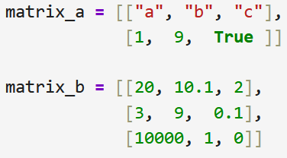
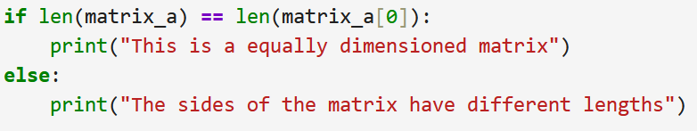
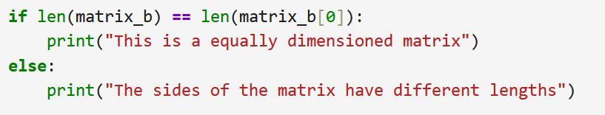
The Problem: Stupid Copy Paste of Code
Tasks 5 / Advanced: Check if matrix side lengths are equal
“Stupid” solution: →Copy paste
+
Notes:
@ Erik bin mir nicht sicher, ob das der beste Einstieg in das Thema ist.
This is obv. very repetitive.
There is a slightly better way with loops, but there is a much better way with functions!

Slide 3
Smart Solution: Functions → Reuse of Code
Been using functions all the time:
print()
sum()
int()
Logic:
Input in “()”
Output: Either text display or saved to a variable
“Hello”
Display text
Hello (in console)
[1, 2, 3]
Add all elements
6
3.1415
Remove decimals
3
Either an assignment and / or a visual output
Input
Function Logic
Output
Notes:
Before creating our own functions, let’s look at functions we have used before.
@Erik: Hier hab ich schon Animation hinzugefügt, da sonst nicht offensichtlich ist, wie ich mir diese Folie gedacht habe

Slide 4
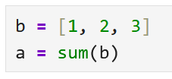
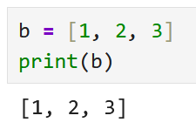
How we use functions
Input → Function Logic → Assignment:
Input → Function Logic → Visual Output:
Notes:
@ Erik hier schon die grobe Animationslogik. Man könnte statt dessen auch die Pfeile erst ausblenden, und dann nach und nach einfügen
ÜBERLEGUNG: Diese Slide vor die andere Slide?

Slide 5
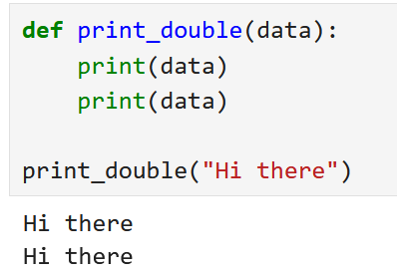
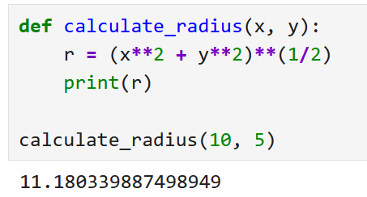
Live Coding: How to Create Functions
Input
Without Assignment: (Single Input)
Without Assignment: (Multiple Input)
colon
Logic
Comma separated input

Slide 6
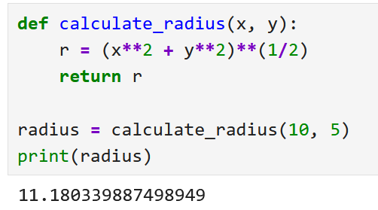

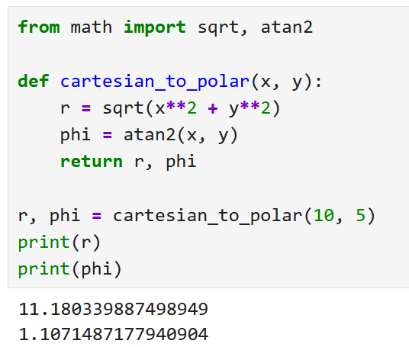
Live Coding: How to Create Functions
With assignment: (Single return)
With assignment: (multiple return)
Function exits after return (even if there is code)
[https://pt.memedroid.com/memes/detail/3846326/Spoiler-alert]
Comma separated return

Slide 7
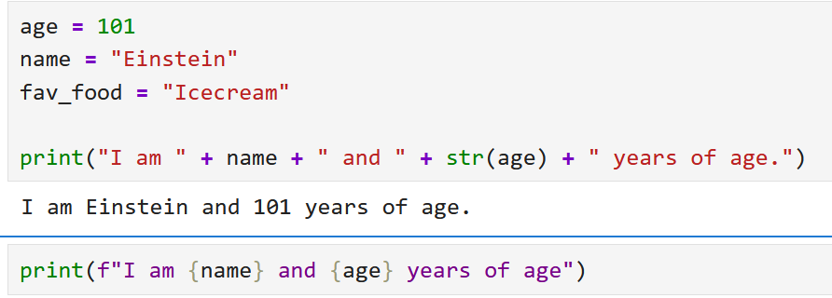
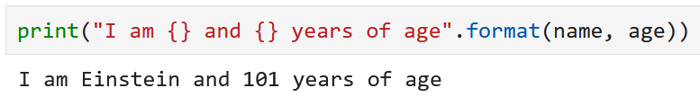
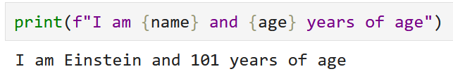
Off topic: f-strings
Inserting a lot of variables in a string with “+” is tedious:
Alternative with format():
Alternative with f-string:
Winner 🎉

Slide 8
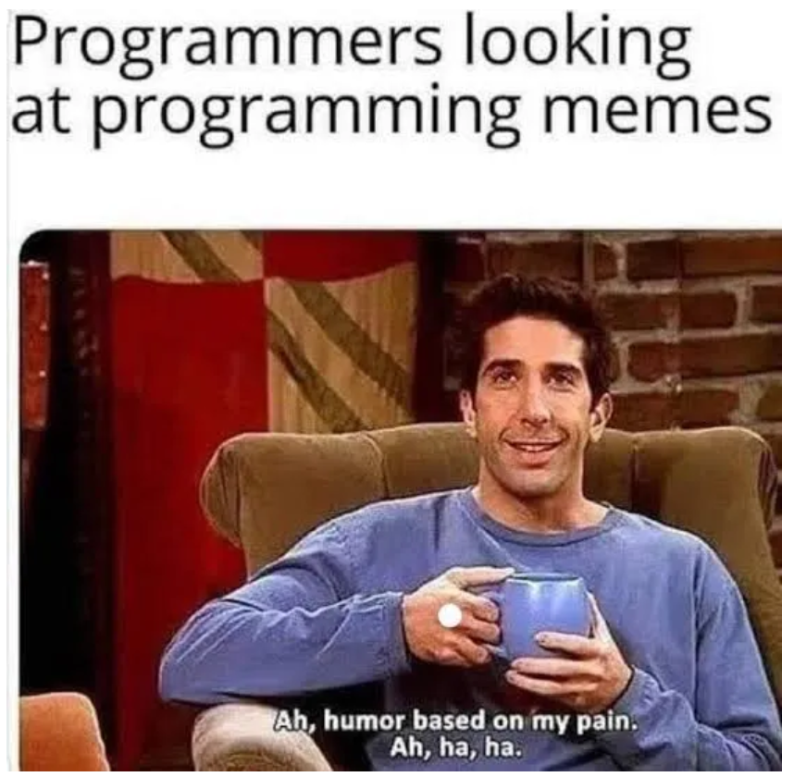
Good Luck with your Tasks ☺

